Slide 1
Create a matrix of size 50x50 of numbers ranging from 0 to 9 and find the length of the largest sorted component reversed horizontally
HRITIK SHARMA (IIT 2019020) SHREYANSH PATIDAR (IIT 2019018) BISWAJEET DAS (IIT 2019019)

Slide 2
Abstract
This Paper contains the algorithm to create a matrix of size 50x50 of numbers ranging from 0 to 9 and to find the length of the largest sorted component reversed horizontally. Two approaches have been taken and we will see the difference in complexity between both.

Slide 3
Contents
Introduction
Algorithm Design
Algorithm Analysis
Values of O(n) for all approaches
Time complexities of all algorithms and comparison b/w all
Conclusion
References

Slide 4
INTRODUCTION
A subsequence is a sequence contained in or forming part of another sequence.Sorting is the process of arranging the elements of a set in a fashionable order i.e either in ascending or descending order of the elements of the set.
This report further contains -
II. Algorithm Design
III. Algorithm Analysis
IV. Result
V. Conclusion
VI. Result

Slide 5
ALGORITHM DESIGN
Approach 1:
1. Assign values to a 2 D array of desired length using random function (n=50 in problem)
2. Iterate over a loop through the entire 2D array row wise.
3. In each row , use a dynamic programming approach to obtain its largest sorted sequence length.
4.Compute optimized LIS values in bottom up manner for each row.
5. For each row , store the value of its longest sorted sequence in an array row_wise_max[n].
6.print the maximum of all numbers in row_wise_max[n] array.

Slide 6
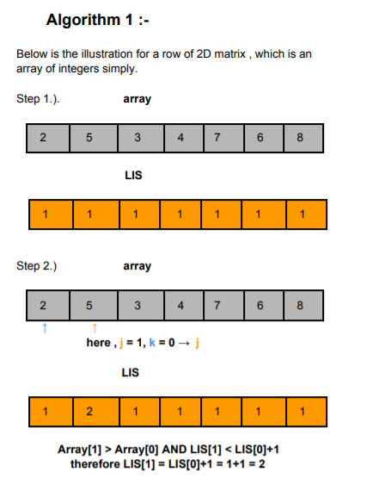
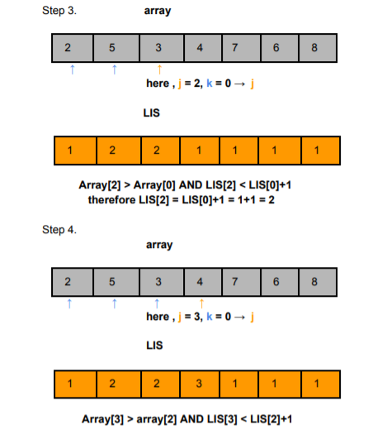

Slide 7
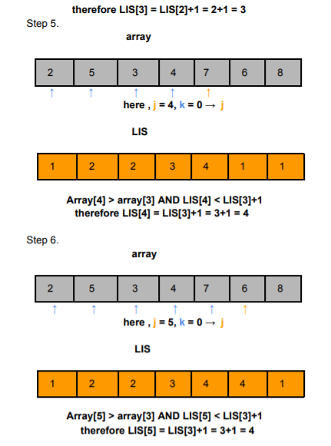
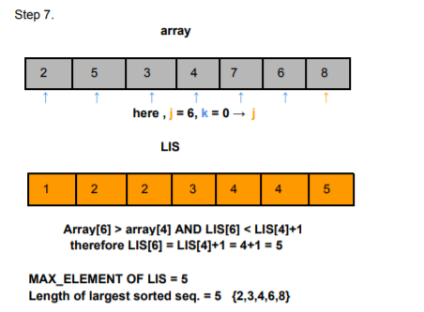

Slide 8
Algorithm 1:
int a[n][n] , LIS[n],row_wise_max[n];
for(i: 0→n-1 ){
LIS[n] = {1};
for( j: n-2→0 ){ // reverse iteration
for(k: n-1→j-1)
{ if(a[i][j] >= a[i][k] && LIS[j] < LIS[k]+1)
LIS[j]=LIS[k]+1;
}
}
Row_wise_max[i] = maximum(LIS[n]);
}
Ans = maximum(row_wise_max[n]);
print(Ans);

Slide 9
ALGORITHM DESIGN
Approach 2:
1.Traverse 2D array row-wise.
2. Make a new arr[] array and assign value a[i][n-1] to arr[0] for each row i . Now using pointer to arr[] elements iterate remaining array a[0][j] row wise , if the next element in a[0][j] is greater than or equal to the last element of arr[] then insert this element into arr[] else replace this element in place of element in a[0][j] which is just greater than that element.
3. Insertion here will be based on binary search technique(divide and conquer) and simple comparison.
4. Store the length of the longest sorted sequence of each row in the row_wise_max[] array.
4. We will follow the same steps for each row in the 2D array.
5. The maximum of all elements in the row_wise_max[] array would be the answer.

Slide 10
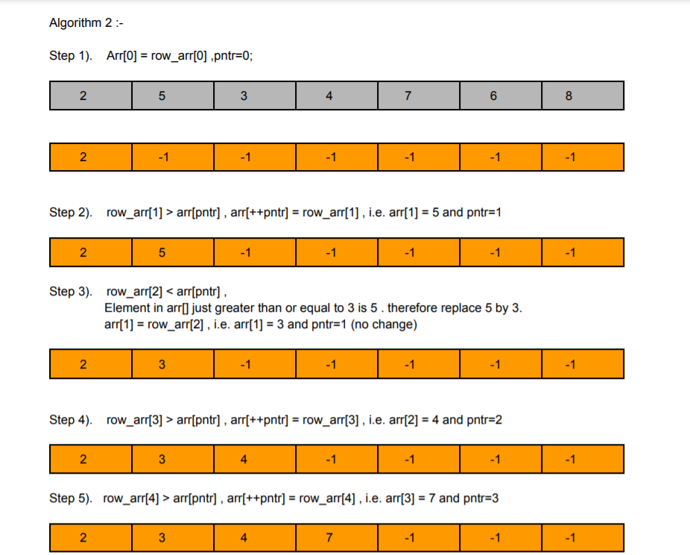

Slide 11
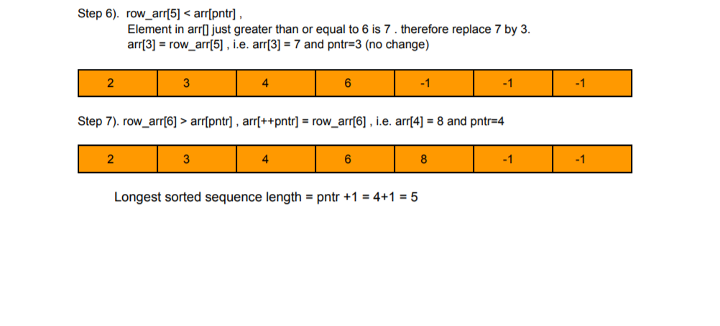

Slide 12
Algorithm 2:
ans = -1;
while (low <= high) {
int mid = low + (high - low + 1) / 2;
if (arr[mid]< key) low = mid + 1;
else if (arr[mid]> key) {
ans = mid;
high = mid - 1;
}
else if (arr[mid] == key) low = mid +1;
}
return ans;

Slide 13
int a[n][n] , arr[n] , row_wise_max[n],pntr;
for(i: 0→n-1 ){
pntr=0,arr[0] = a[i][n-1];
for( j: n-2→0 ){
If (a[i][j] < ans_arr[0]) ans_arr[0]=a[i][j];
else if (a[i][j] >= ans_arr[pntr]) ans_arr[++pntr] = a[i][j];
else {
index = search(ans_arr,0,pntr,a[i][j]);
ans_arr[index] = a[i][j];
}
Row_wise_max[i] = pntr + 1;
}
Ans = maximum(row_wise_max[n]);
print(Ans);

Slide 14
ALGORITHM ANALYSIS
Approach 1:
For each row, the DP approach for LIS takes time ∝ n² . for each row , we need extra time ∝ n to calculate the maximum element in LIS.
Here the maximum value of n=100
So the time complexity will be O(n(n + 2*n*(n+1)/2 + n ) ) = O(3*n² + n³)
t_{best}: when n=0, = O(0) = 0ms
t_{worst}: when n=100 , t_{worst} = O(2.03 * (10⁶))
Approach 2:
Here, traversing over each row with size n will take time ∝ n . Finding pos for each element will take maximum log(n) time. And insertion operation will take time ∝ n.
So, the time complexity will be O(n*n*log(n)).
t_{best}: when n=0, = O(0) = 0ms
t_{worst} : when n=100 ,=O(2*10⁴)

Slide 15
VALUES OF O(N) FOR BOTH ALGORITHMS
SNo. | N | Algo1 | Algo 2
1 | 0 | 0 | 0
2 | 10 | 1300 | 200
3 | 20 | 9200 | 520.41
4 | 30 | 29700 | 1329.409
5 | 40 | 68800 | 2563.435
6 | 50 | 632500 | 4247.425

Slide 16
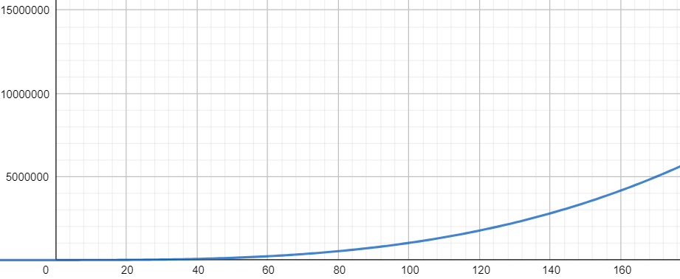
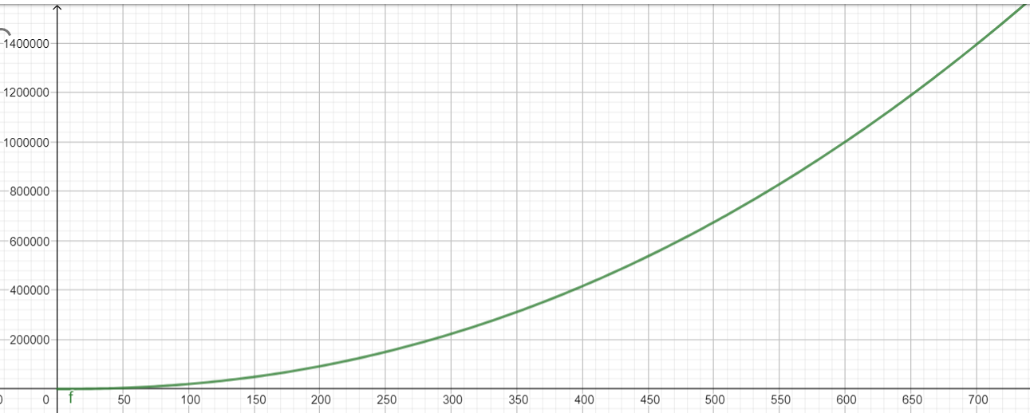
TIME COMPLEXITIES OF ALGO 1 & 2
Algo 1 Time Complexity
Algo 2 Time Complexity

Slide 17
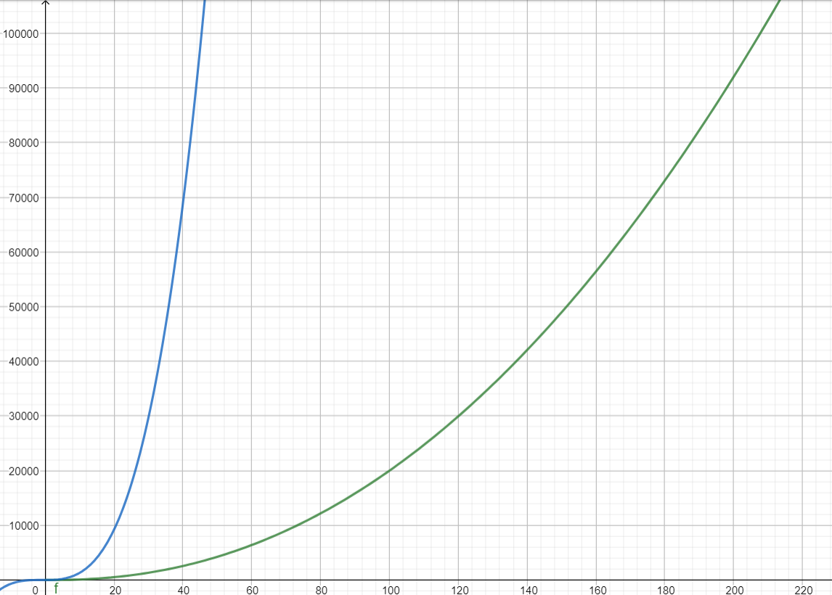
TIME COMPLEXITY OVERALL COMPARISON
1
2
Time Complexity Comparison between Algo 1 and Algo 2

Slide 18
CONCLUSION
Above two methods have different time complexities and meet to fulfill the problem statement. The order in which they are good can be listed as:
I. Approach 2
II. Approach 1
Based on the time complexities.

Slide 19
Reference
https://en.wikipedia.org/wiki/Subsequence

